Slide 1

DD 521 SYSTEM DESIGN FOR SUSTAINABILITY
Design of a Product service System for Post-Disaster Relief Material Supply and Logistics Management
Course Instructor:
Dr. Sharmistha Banerjee
Submitted by:
234357003 Waquar Ul Islam
234357002 Mayank Hedau
236157002 Noksenkokla Jamir
236157003 Pankaj Kavidayal

Slide 2
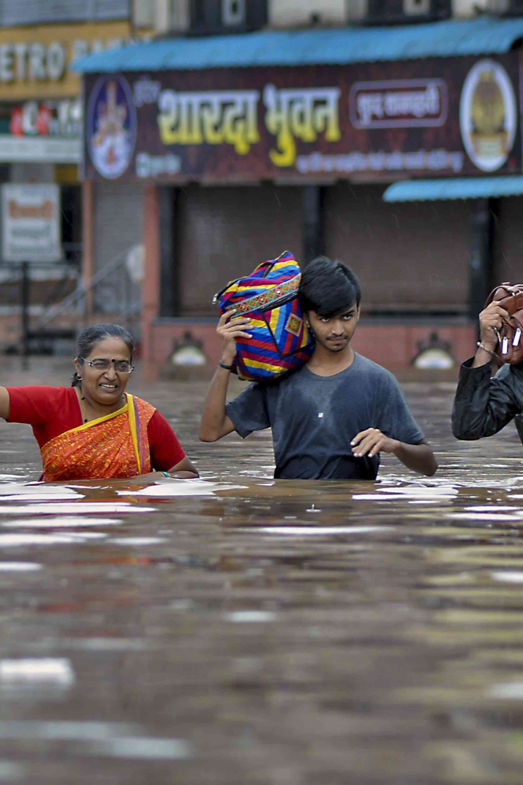
Assam is prone to devastating floods every year, causing immense damage and disrupting livelihoods. We present a comprehensive system to facilitate efficient supply and logistics management for relief operations.
In response to the critical need for efficient and effective post-disaster relief efforts, our proposed Product-Service System (PSS) integrates digital tools, and support services to streamline supply chain logistics and enhance the overall disaster response process and sustainable practices to ensure a comprehensive and adaptable approach.

Slide 3
Project Name: Design of a Product service System for Post-Disaster Relief Material Supply and Logistics Management
Satisfaction Unit: Stakeholders involved, including affected communities, relief workers, and collaborating organizations
Concept Description
Efforts are aimed at providing immediate support to affected communities and helping them to rebuild and recover in the longer term.
The relief system aims to offer both immediate relief and sustainable support for the affected population.
Recognition of specific challenges faced by women in post-disaster scenarios.
Emphasizes the importance of collaboration among various organizations and individuals.
More focus is on the Logistics part for quick and accurate assessment of affected areas, identifying critical needs and obstacles.

Slide 4
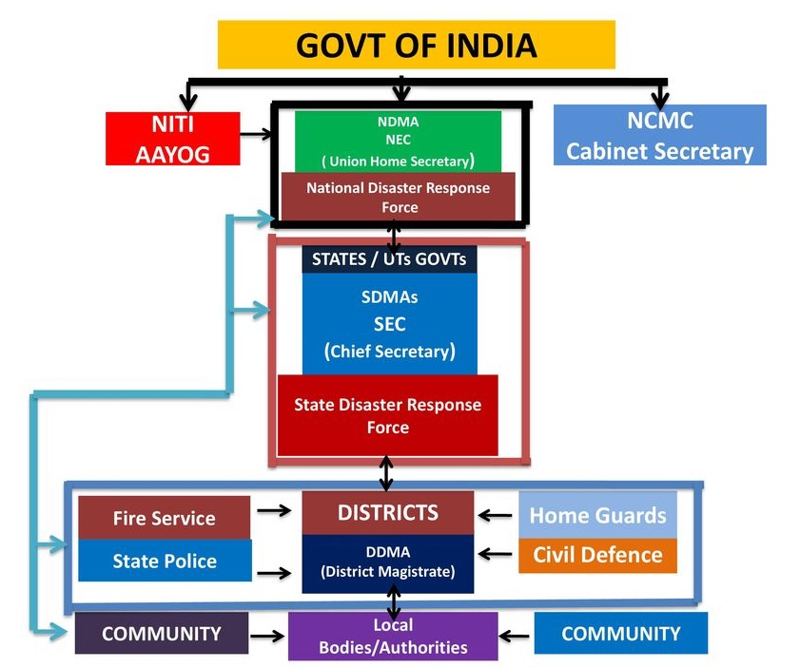
Initial efforts would always be made by the District Administration.
When District is overwhelmed in any situation, the support necessarily has to come from the State and National Level.
Responsible Officer (RO) within the jurisdiction control will trigger the activation for various levels of disaster.
DM arrangement in Assam is based on a four tired structure and recognizes all four levels

Slide 5
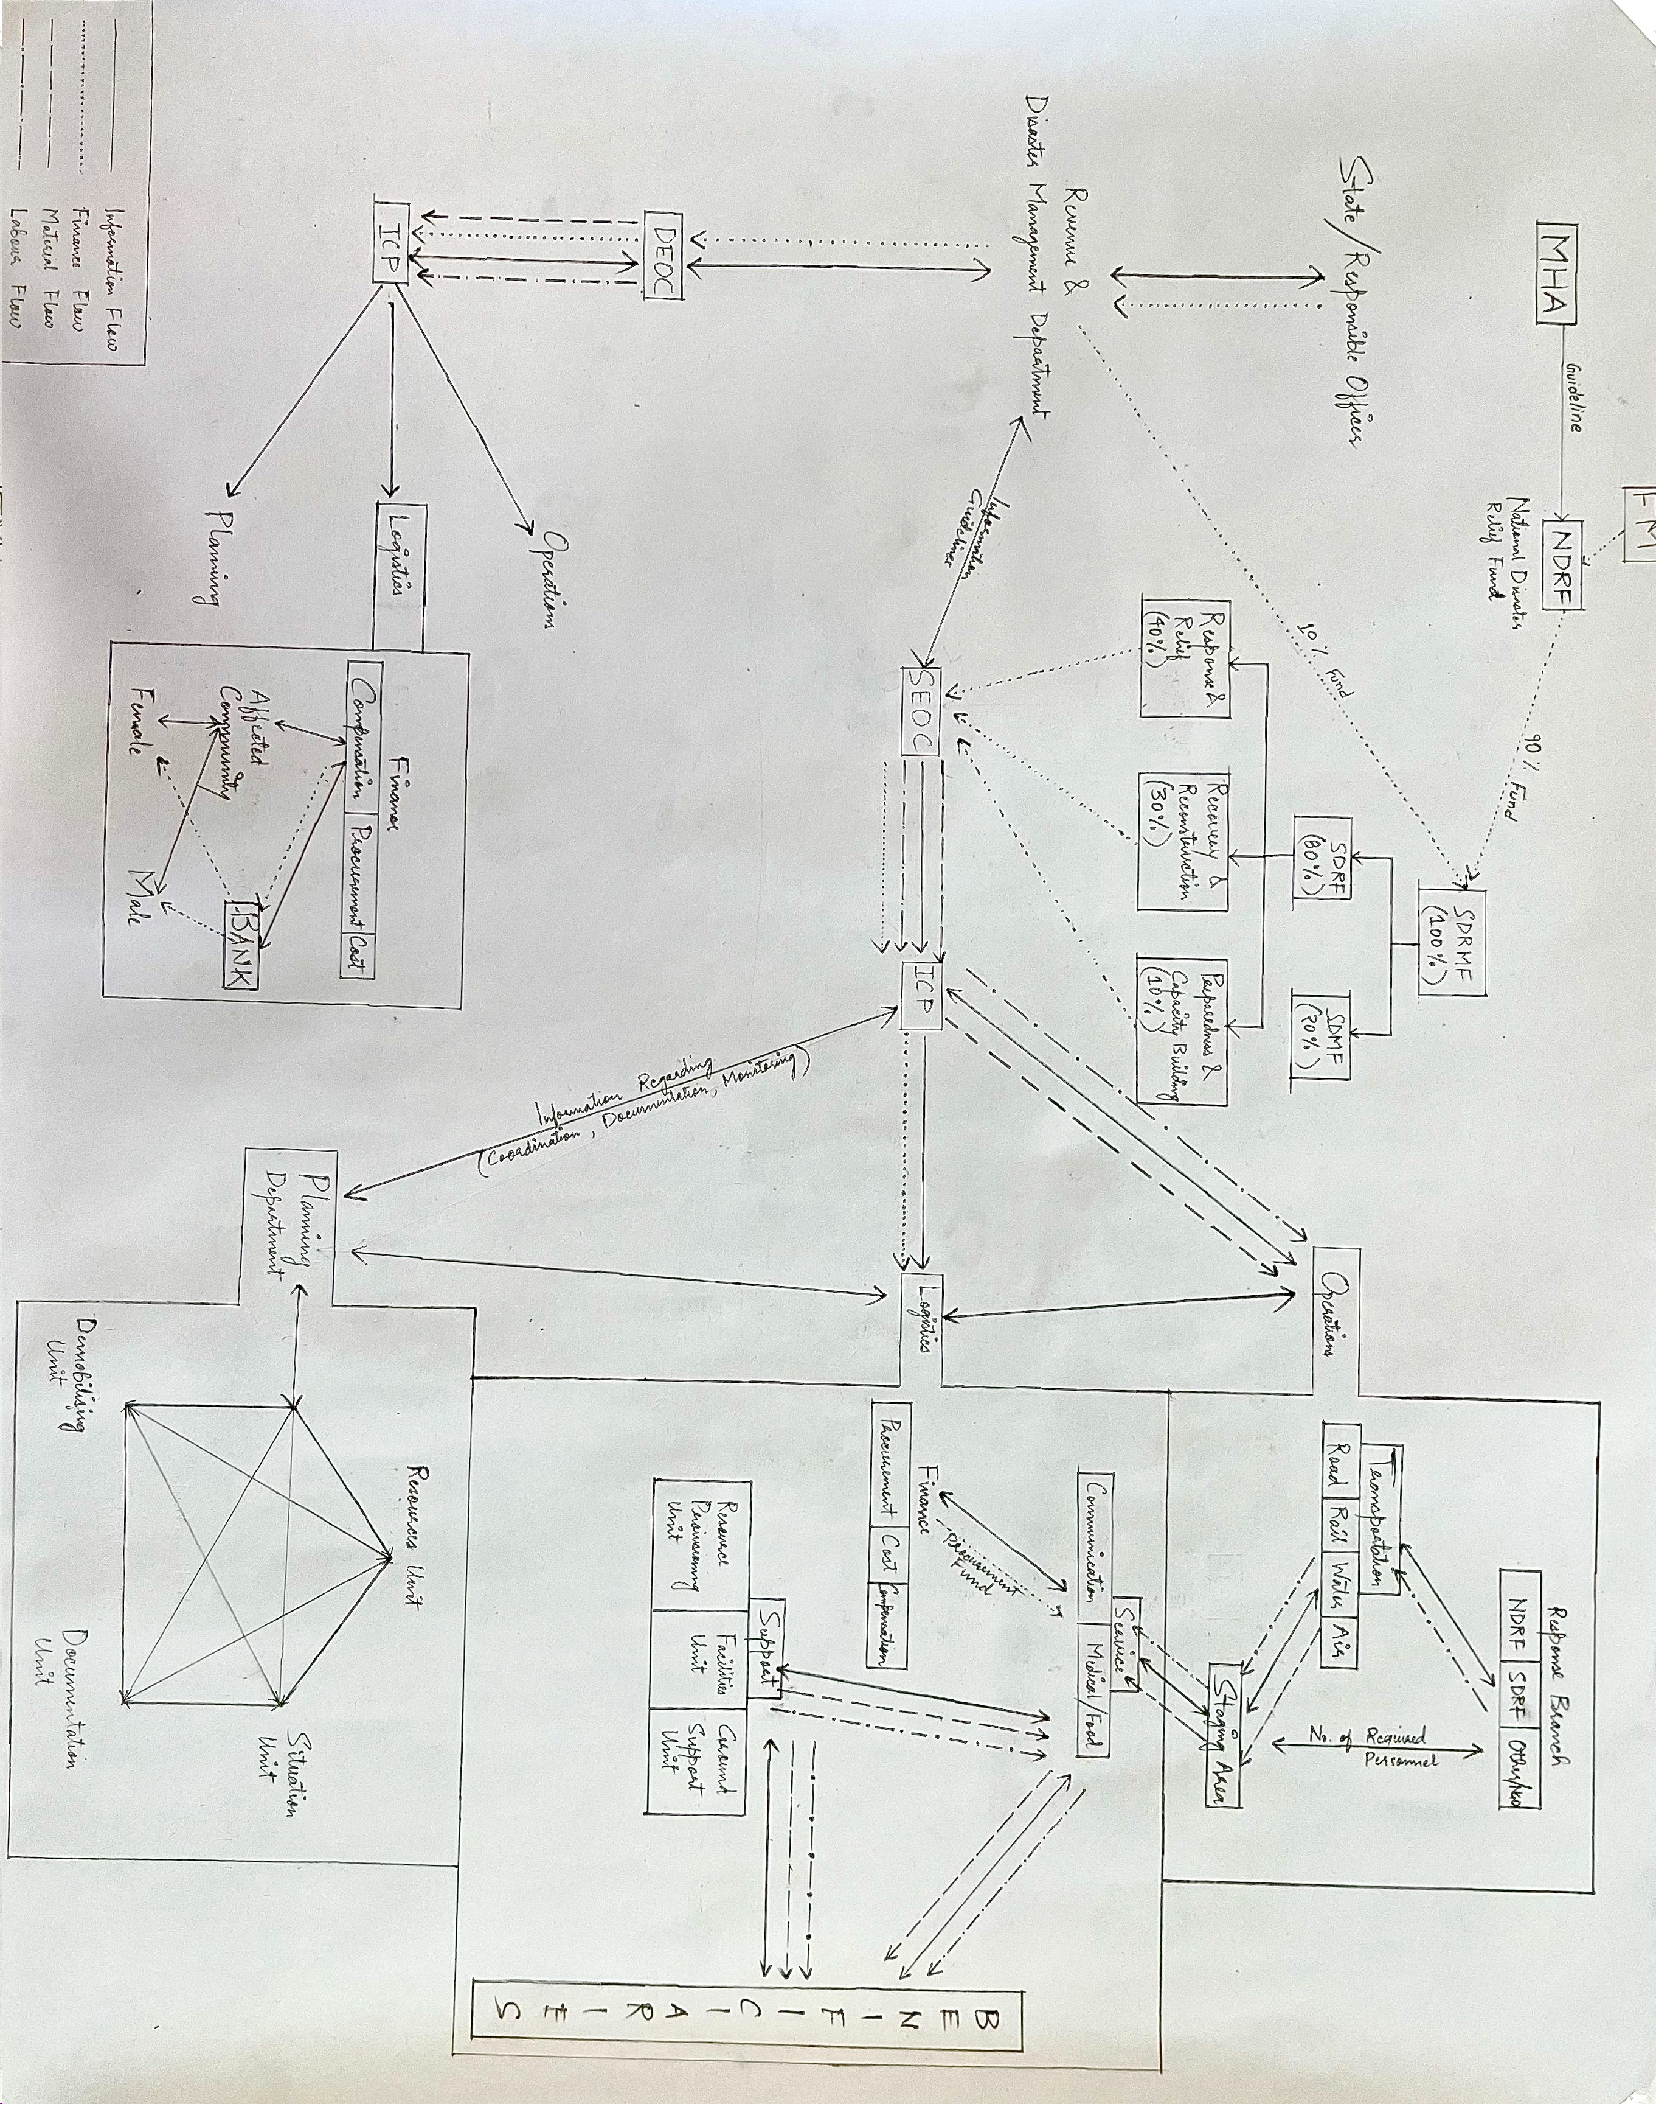
EXISTING SYSTEM

Slide 6
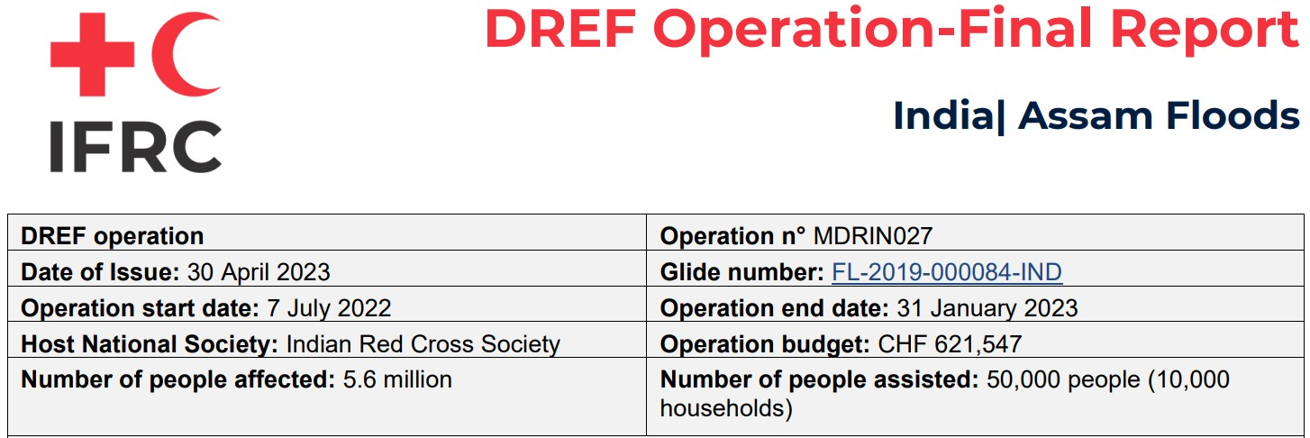
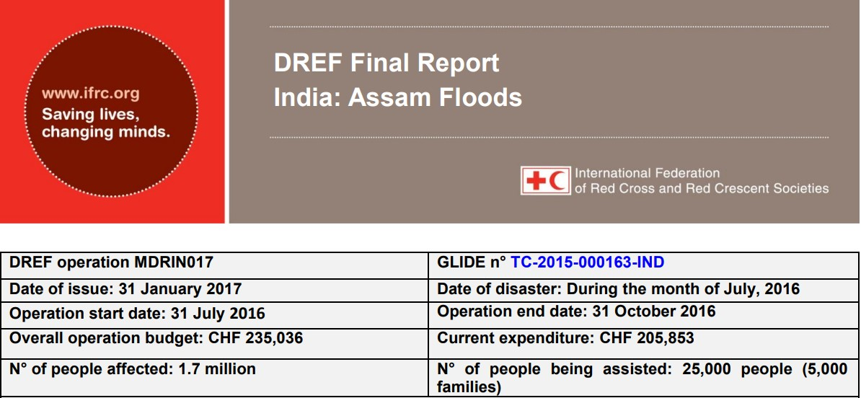
CASE STUDIES
Case study 1
Case study 2

Slide 7
Challenges associated
Water, Sanitation and Hygiene
Information management by the branches was challenging. No records on gender, age, impact of the sessions were maintained.
Convincing the communities that water purified by the units are safe for drinking was challenging.
People were hesitant to allow Red Cross to install the water purification units as they were not aware of its functioning and purification process.
Quality programming / areas common to all sectors
There is no established system or guidelines for volunteer allowances or allowances for other surge capacity tools such as NDRT, SDRT, DDRT, ODK, etc.
While there is recognition to work in partnerships, the state branches are seeking guidance and policy of Red Cross to work in partnerships.
Lessons Learned
It’s recommended that the water purification units be prepositioned at Noonmati warehouse in Assam so that deployment of these units can be done immediately after the disaster.
Good planning, deployment of surge capacity and good coordination ensures operational success.
Coordination and communication among stakeholders clarifies expectations on project deliverables and exchange technical support.

Slide 8
Challenges associated
There is no policy guidance on the scope of Red Cross support in small, medium and large-scale operations. State branches seek policy and strategy guidance from the national headquarters.
Strengthen National Society
As IFRC did not receive a list of volunteers from the National Society, the volunteers could not be covered under Global Insurance during the implementation timeframe.
Lessons Learned
Open dialogue, exchange of experiences, sharing of
information contributes to operational success.
It’s important for all stakeholders to understand each
other’s strengths, weaknesses and work together
towards operational aims
A need was highlighted for the development of
standard operating procedures for emergency
operations and policies for volunteer management.
Ensure sufficient prepositioned stocks such as
tarpaulins, mosquito nets, kitchen sets and other non-
food items.
Fast track fund transfer to expedite implementation.

Slide 9
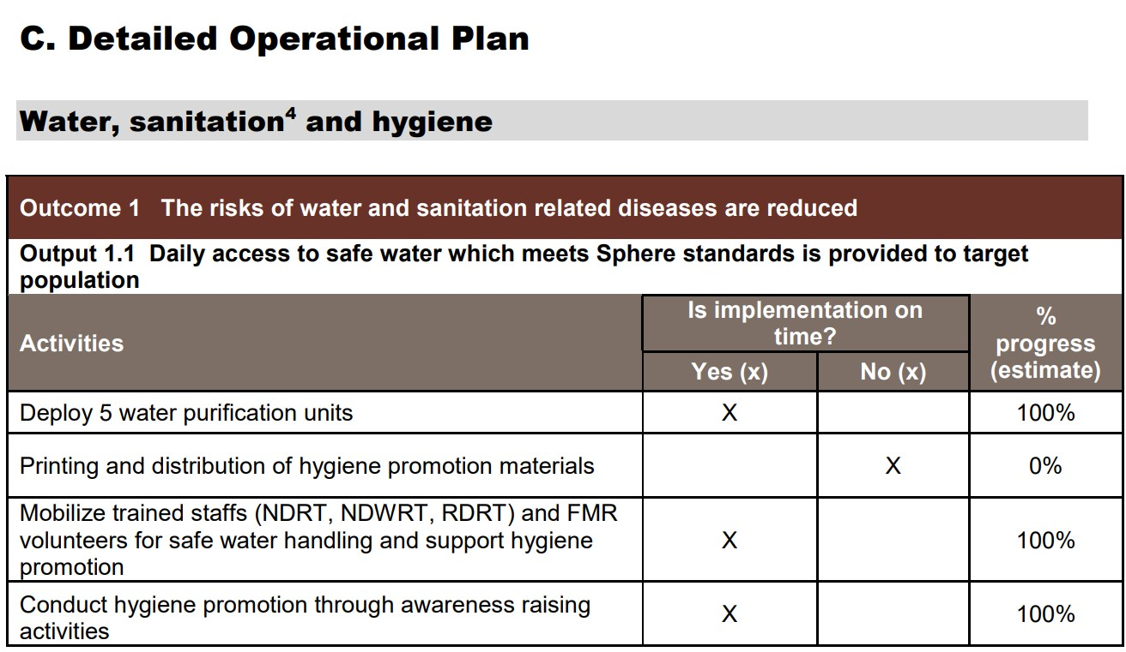
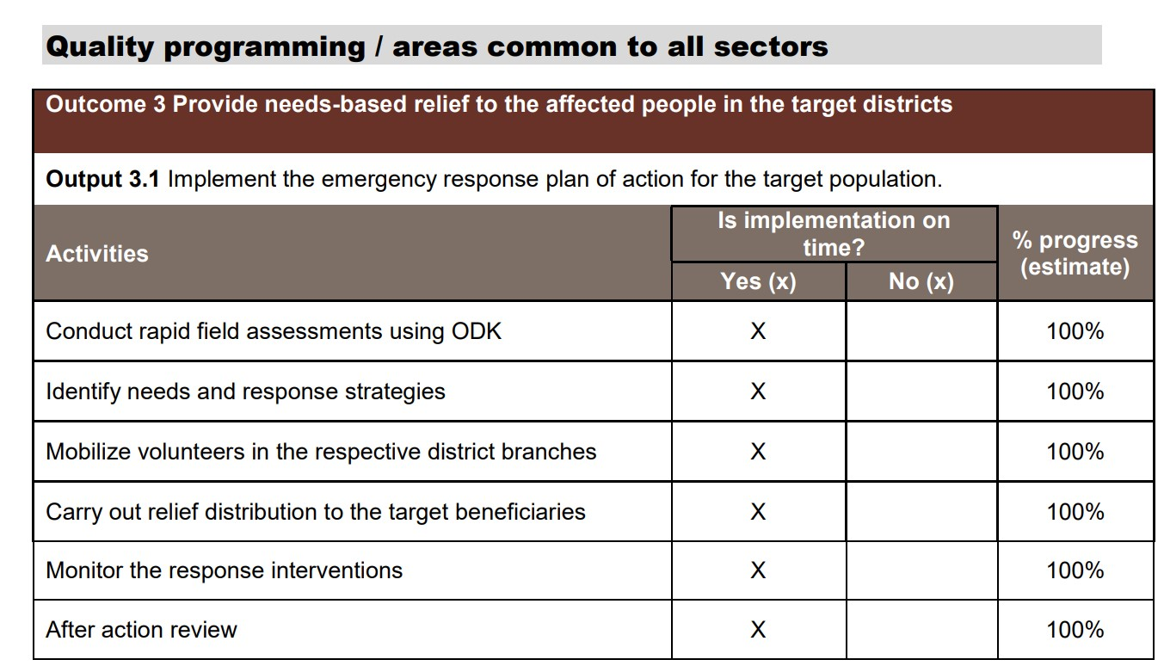
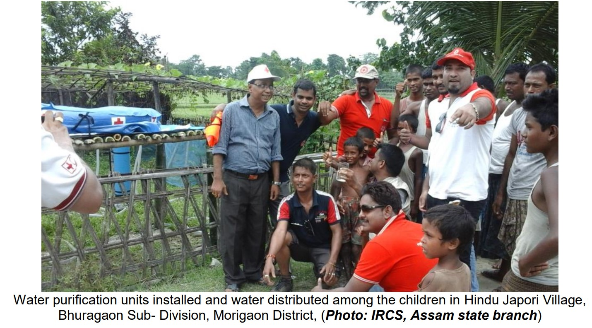
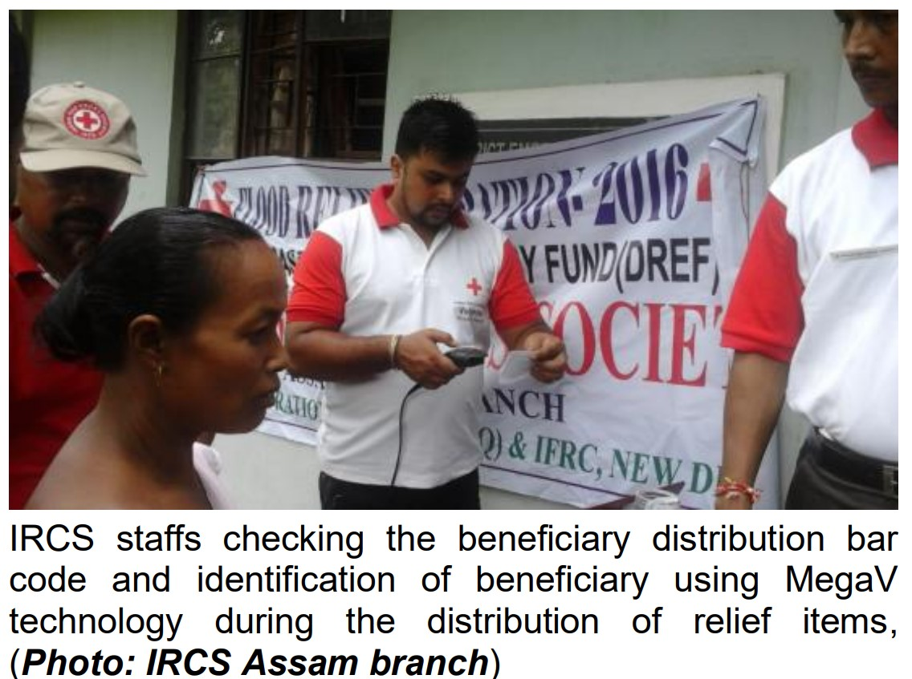
Outcomes

Slide 10
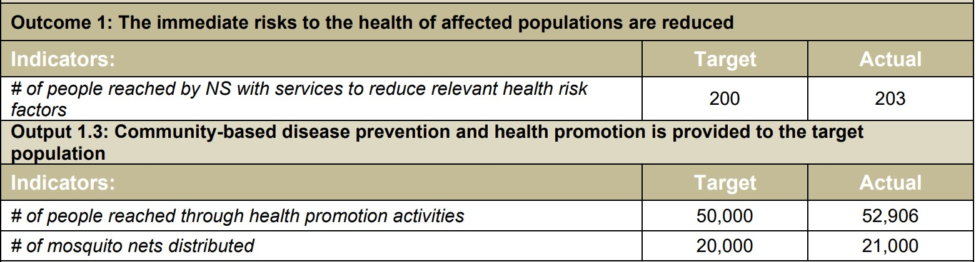
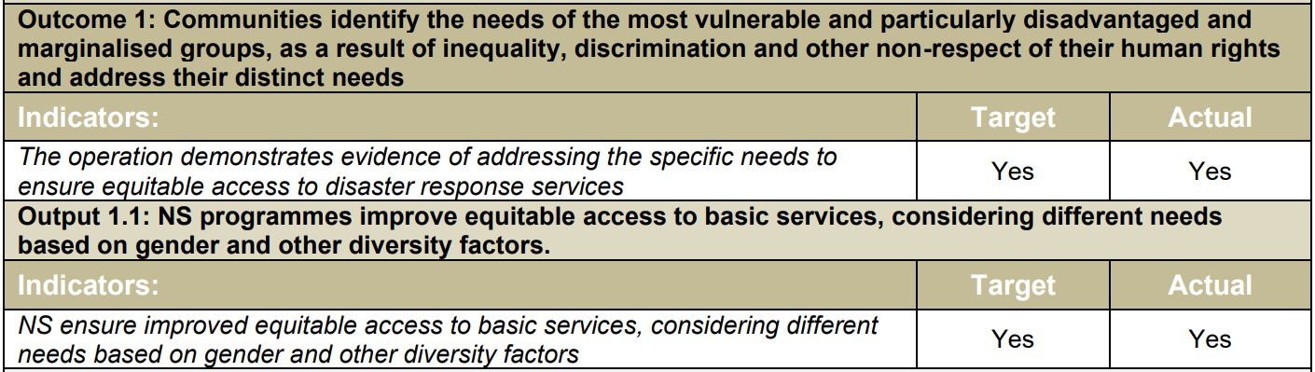
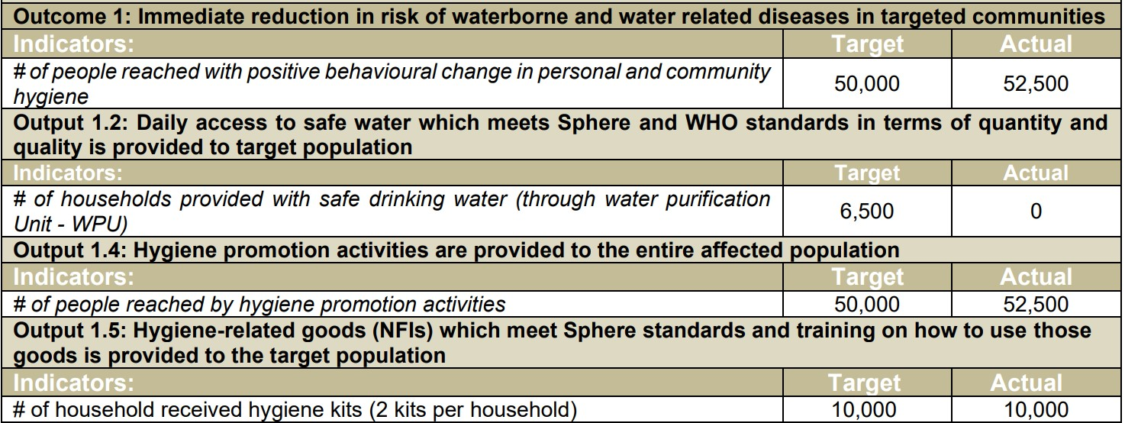
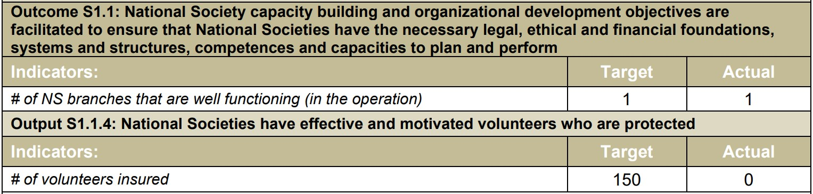
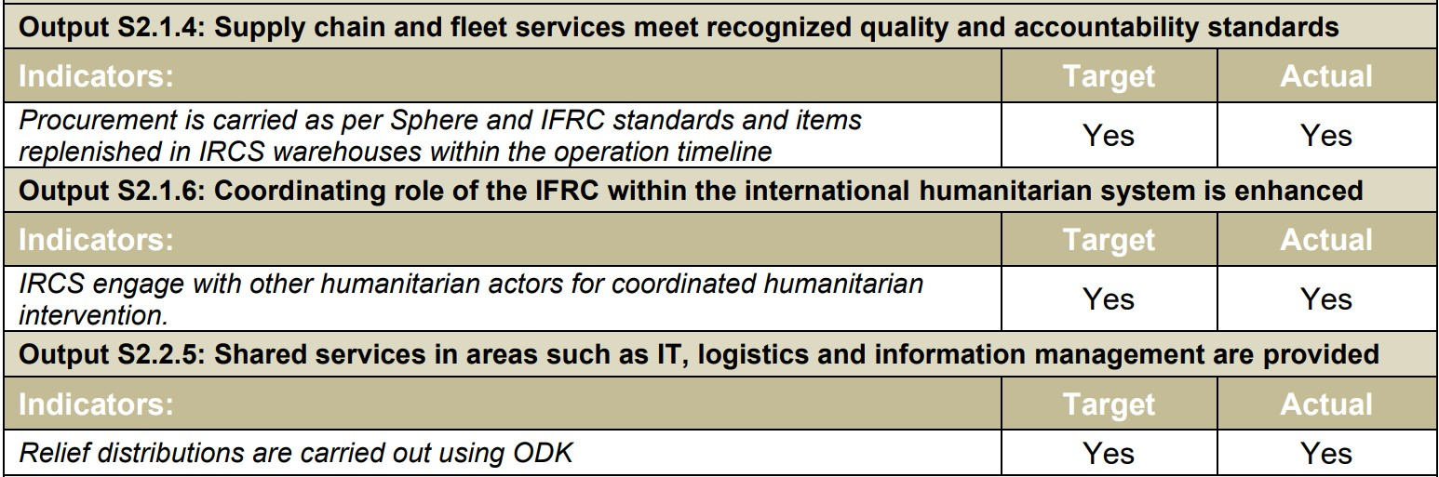
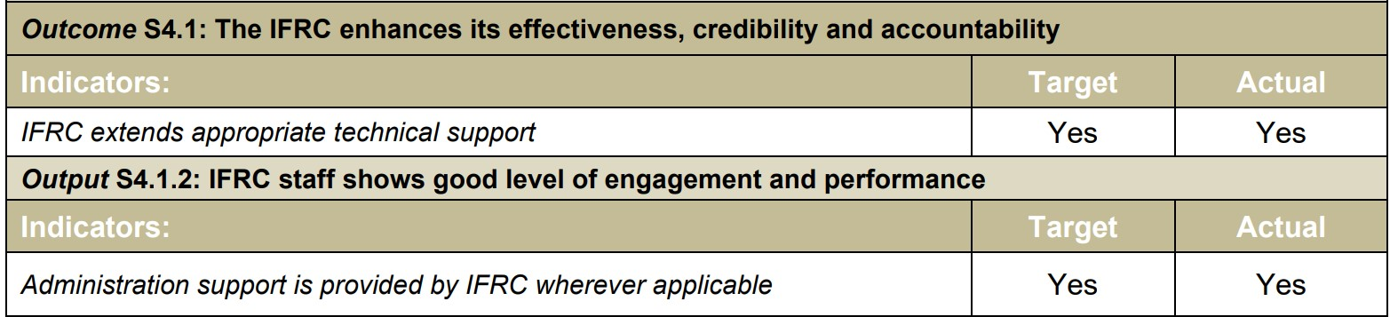
Health
Protection, Gender & Inclusion
Water, Sanitation & Hygiene
Strengthening National Society
International Disaster Response
Effective, credible and accountable IFRC

Slide 11
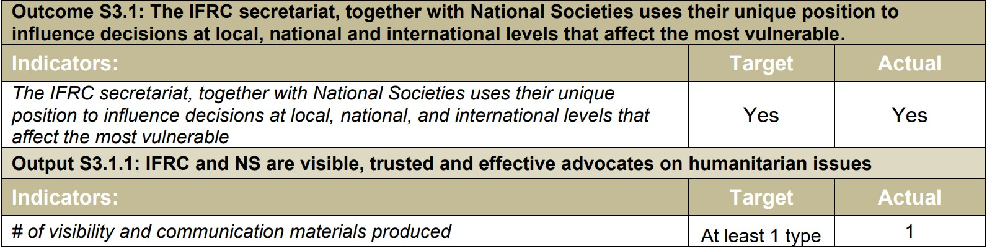
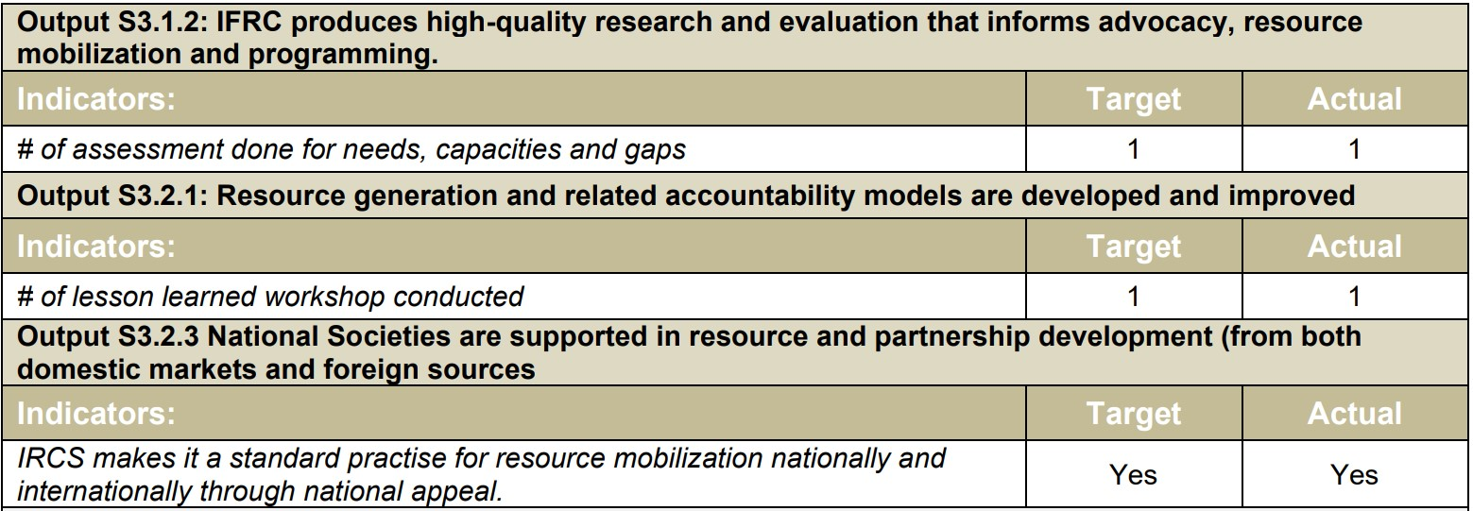
Influence Others as Leading Strategic Partners

Slide 12
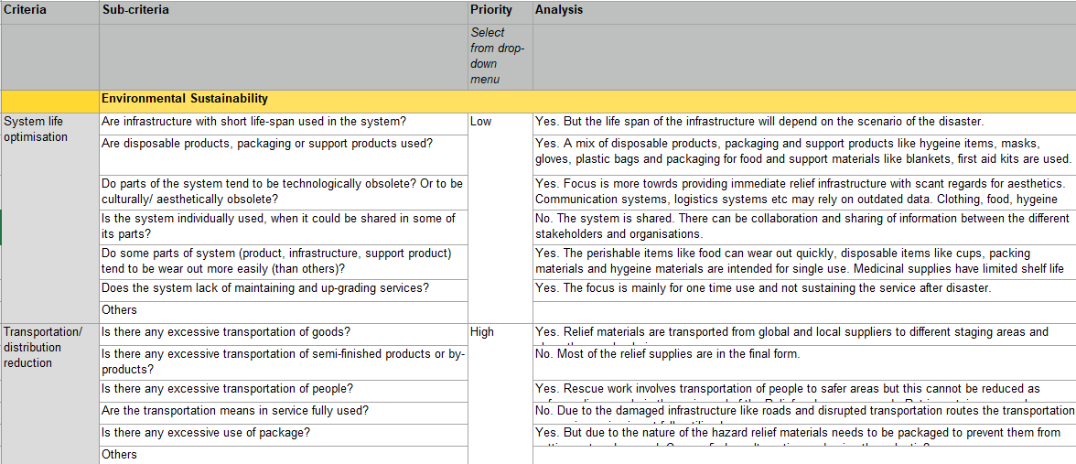
SDO Tool: Analysis and Priorities of the existing disaster Response System in place

Slide 13
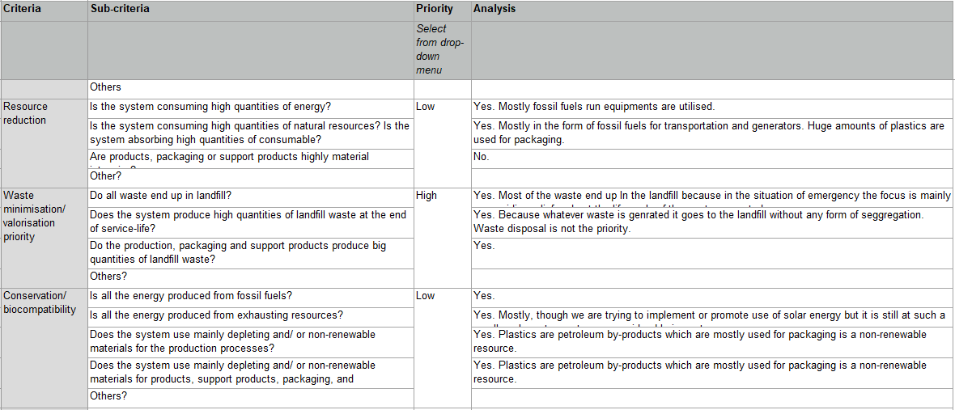

Slide 14
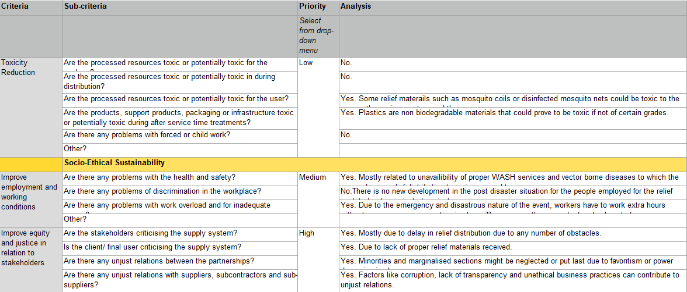

Slide 15
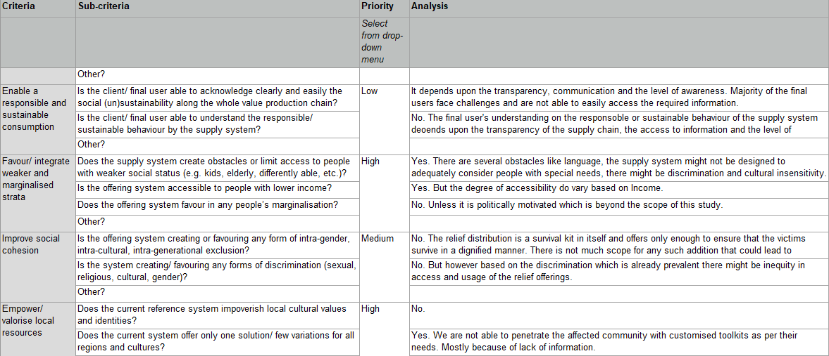

Slide 16
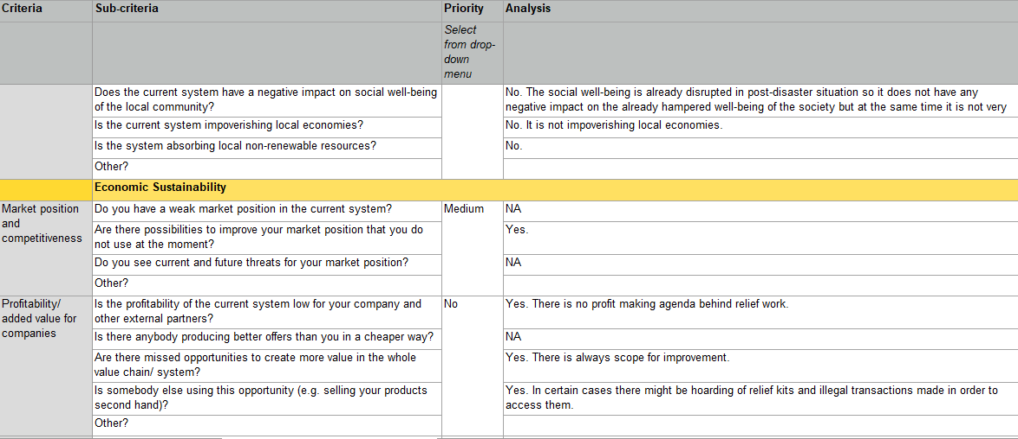

Slide 17
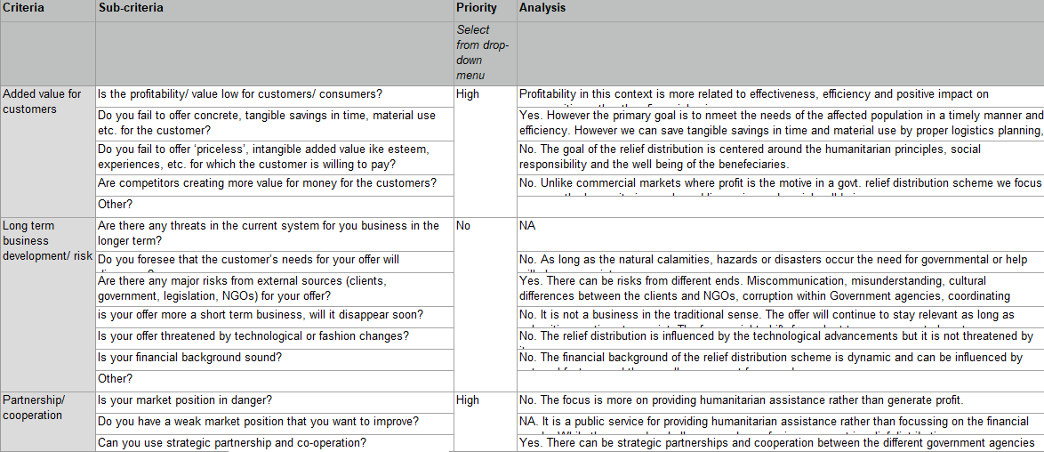

Slide 18
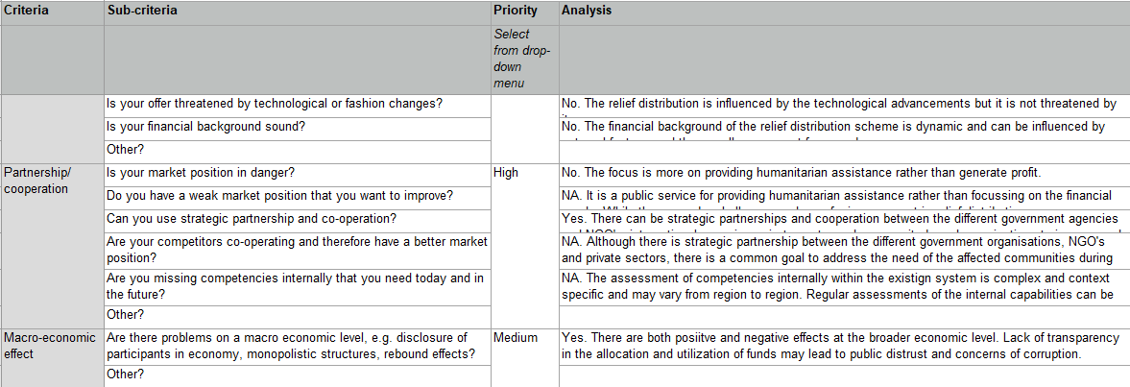

Slide 19
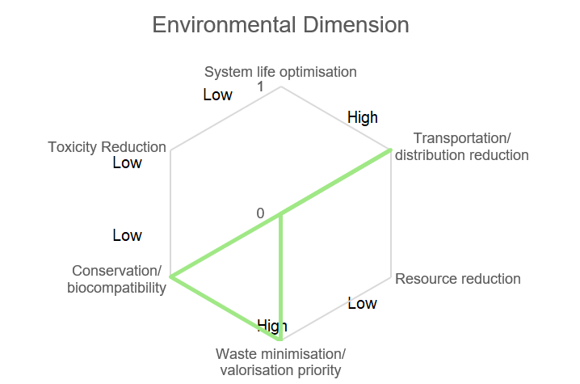
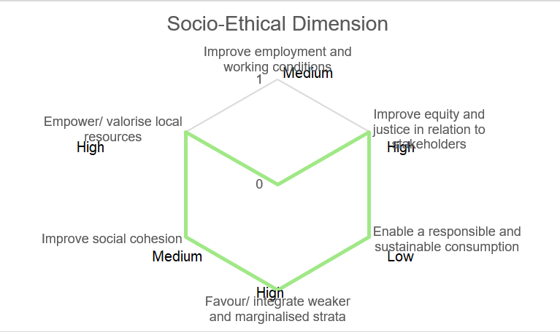
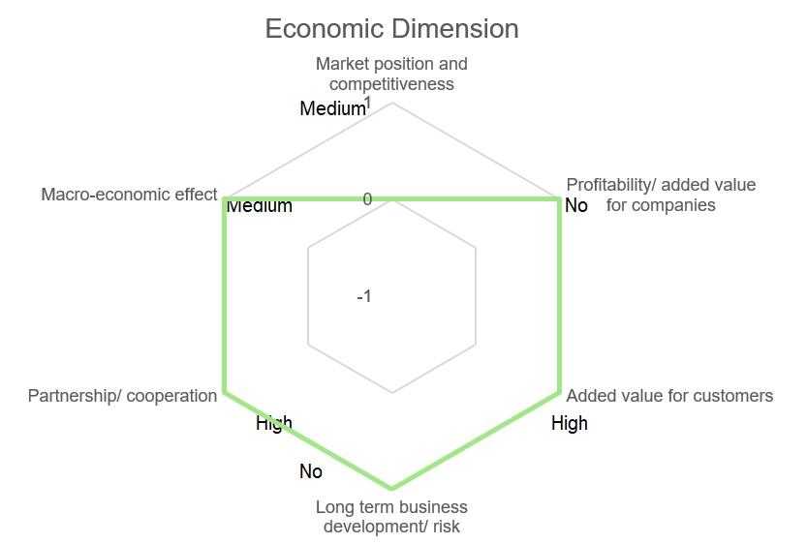
RESULTS: Radar Diagram

Slide 20
CHALLENGES WITHIN THE SYSTEM
Communication and Coordination
Logistical Challenges
Resource Allocation
Community Engagement
Environmental Impact

Slide 21
Communication and coordination
Logistic challenges
Resource Allocation
Effective communication can better the flow of information between the different parties involved in the supply chain, helping to ensure that resources are allocated efficiently and quickly.
Coordination between supply chain partners can also ensure that everyone is aware of the needs and goals of the relief effort, allowing for more effective resource management.
Using technology such as blockchain can help increase transparency and security in the supply chain, making it easier to track and manage resources.
Include limited resources, unpredictable demand, and competing priorities.
Utilizing data analytics to predict demand, optimize routes, and allocate resources efficiently.
Introduction to priority-based resource allocation. Categorizing resources based on urgency and importance.
Include limited resources, unpredictable demand, and competing priorities.
Utilizing data analytics to predict demand, optimize routes, and allocate resources efficiently.
Introduction to priority-based resource allocation. Categorizing resources based on urgency and importance.

Slide 22
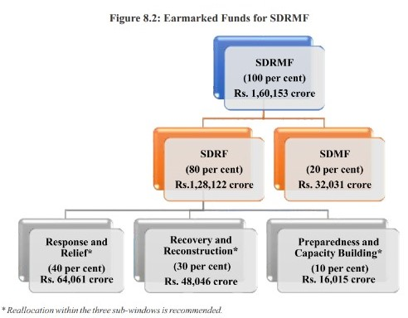
Structural distribution of finance

Slide 23
Cash transfer from SDRF to disaster affected people including cash assistance to women for their empowerment
At present, there is no provision in the norms prescribed by the Ministry of Home Affairs for cash transfer of assistance to victims of disasters including cash assistance to women for their empowerment.
The XV Finance Commission had specifically considered this issue and mentioned in their report that at the community and household level, disaster funds also need to be considered as means of transfer of resources to the people.
Given the gender imbalances within households, the Commission has observed that cash assistance should be transferred to families in a way that women members of the household also get access to the money.
This is an area which requires significant reforms in recognizing the legal rights of women and their central role in ensuring the wellbeing of families.

Slide 24
Benefits of Implementing the System
Efficiency
Transparency
Resilience
Streamline relief operations, reduce response time, and optimize resource allocation, enabling faster and more targeted support for flood-affected communities.
Enable real-time tracking of relief materials, monitoring of distribution, and effective coordination among stakeholders, ensuring transparency and accountability.
Strengthen the capacity to cope with future floods through improved preparedness, early warning systems, and efficient use of resources.

Slide 25
References
Kovács, G., & Spens, K. M. (2007). Humanitarian logistics in disaster relief operations. International journal of physical distribution & logistics management, 37(2), 99-114.
Sheu, J. B. (2007). An emergency logistics distribution approach for quick response to urgent relief demand in disasters. Transportation research part E: logistics and transportation Review, 43(6), 687-709.
Negi, S., & Negi, G. (2021). Framework to manage humanitarian logistics in disaster relief supply chain management in India. International Journal of Emergency Services, 10(1), 40-76.
Jana, R. K., Chandra, C. P., & Tiwari, A. K. (2019). Humanitarian aid delivery decisions during the early recovery phase of disaster using a discrete choice multi-attribute value method. Annals of Operations Research, 283(1-2), 1211-1225.
Nayeem, M. K., & Lee, G. M. (2021). Robust design of relief distribution networks considering uncertainty. Sustainability, 13(16), 9281.
https://asdma.assam.gov.in/sites/default/files/swf_utility_folder/departments/asdma_revenue_uneecopscloud_com_oid_70/this_comm/asdmp_vol-_i
https://asdma.assam.gov.in/sites/default/files/swf_utility_folder/departments/asdma_revenue_uneecopscloud_com_oid_70/this_comm/asdmp_vol-_ii.pdf
https://www.asdma.gov.in/download/assam_disaster_management_manual_2015.pdf
https://www.wfp.org/publications/wfp-supply-chain-annual-report-2019
https://asdma.assam.gov.in/sites/default/files/Guwahati%20floods.pdf
https://reliefweb.int/report/india/india-assam-floods-dref-operation-no-mdrin027-final-report#:~:text=Though%20the%20inundation%20was%20gradual,women%20and%201.3%20million%20children.
https://fincomindia.nic.in/writereaddata/html_en_files/15thFcReportIndex.html
https://ndma.gov.in/sites/default/files/PDF/COMPENDIUM-OF-LAWS-ON-DISASTER-MANAGEMENT.pdf
https://ndma.gov.in/Capacity_Building/Ops_Comm/IRS

